Slide 1
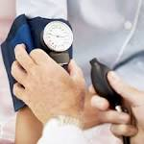

Health Education Unit
Medical and Dental Affairs Division
Take Care of your
Blood Pressure!

Slide 2
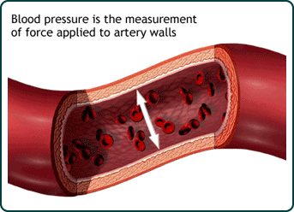
Did you know…
Blood pressure is defined as the force of blood as it pushes against the walls of the arteries when the heart pumps the blood.
High blood pressure could can cause serious health problems such as: coronary heart disease, heart failure, stroke, kidney failure, among others.

Slide 3
Did you know that…
Blood pressure is measured using two numbers:
  The top number, or systolic blood pressure, is the pressure in your blood vessels when your heart beats.
  The bottom number, or diastolic blood pressure, is the pressure in your blood when the heart is at rest between beats.

Slide 4
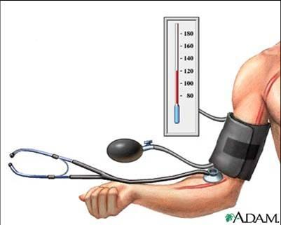
Did you know that …
The desirable value for blood pressure is: 120/80mmHg or less.
It is considered high blood pressure when the levels continually exceed 140/90 mmHg or more.

Slide 5
Did you know that…
Normal levels: | systolic: less than 120 mmHg diastolic: less than 80mmHg
At risk levels: (prehypertension) | systolic: 120–139 mmHg diastolic: 80–89 mmHg
High levels: | systolic: 140 mmHg or higher diastolic: 90 mmHg or higher

Slide 6
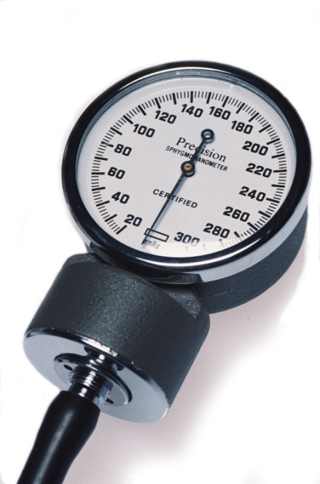
Did you know that …
Some risk factors that can increase blood pressure are:
  Family history
  Diabetes
  Physical Inactivity
  Obesity
  Tobacco Use
  Diet high in sodium

Slide 7
Did you know that …
High blood pressure is called the "silent killer" because it often has no warning signs or symptoms, and many people do not know they have it.
Some common signs are:
    Chest pain
    Headache
    Change in vision
    Irregular heartbeat
    Nosebleeds

Slide 8
Did you know that…
You can prevent high blood pressure by making healthier choices to manage any health conditions you may have.
Practice healthy lifestyles
  Start a healthy diet
  Maintain a healthier weight
  Increase physical activity
  Quit smoking
  Decrease alcohol use

Slide 9
Did you know that…
To control your blood pressure levels, remember to:
Measure your blood pressure frequently
Take your treatment as directed by the physician
Visit and talk with your physician

Slide 10
Reference
http://www.cdc.gov/bloodpressure/about.htm
http://ksw-gtg.com/hbp/guide/#/1/

Slide 11

Thanks for taking care of your health!

